Slide 1
Control System GUI Development @ PSI
Simon Rees :: Software Engineer :: Large Facility Controls Section
Controls GUI and Centralised Application Platforms Workshop September 2022

Slide 2
Introduction
At PSI we are mostly still using traditional (non-web) technologies... But a few of us have been working on pilot projects for the web Some colleagues support this; others view the applicability of the web in the context of our lab with deep skepticism ! In this talk I will focus on the realities of the situation in our lab and my experiences with developing and deploying a new software solution (called “WICA”) which aims to bring our control system to the web.

Slide 3

Traditional approaches to GUI development

Slide 4
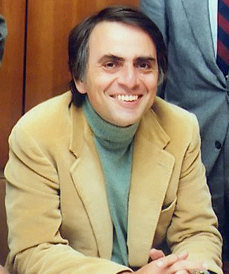

GUI Development at PSI – some context…
“You have to know the past to understand the present” - Carl Sagan 1980
By credit NASA JPL - https://commons.wikimedia.org/wiki/File:Planetary_society.jpg, Public Domain, https://commons.wikimedia.org/w/index.php?curid=24462106,3295528

Slide 5
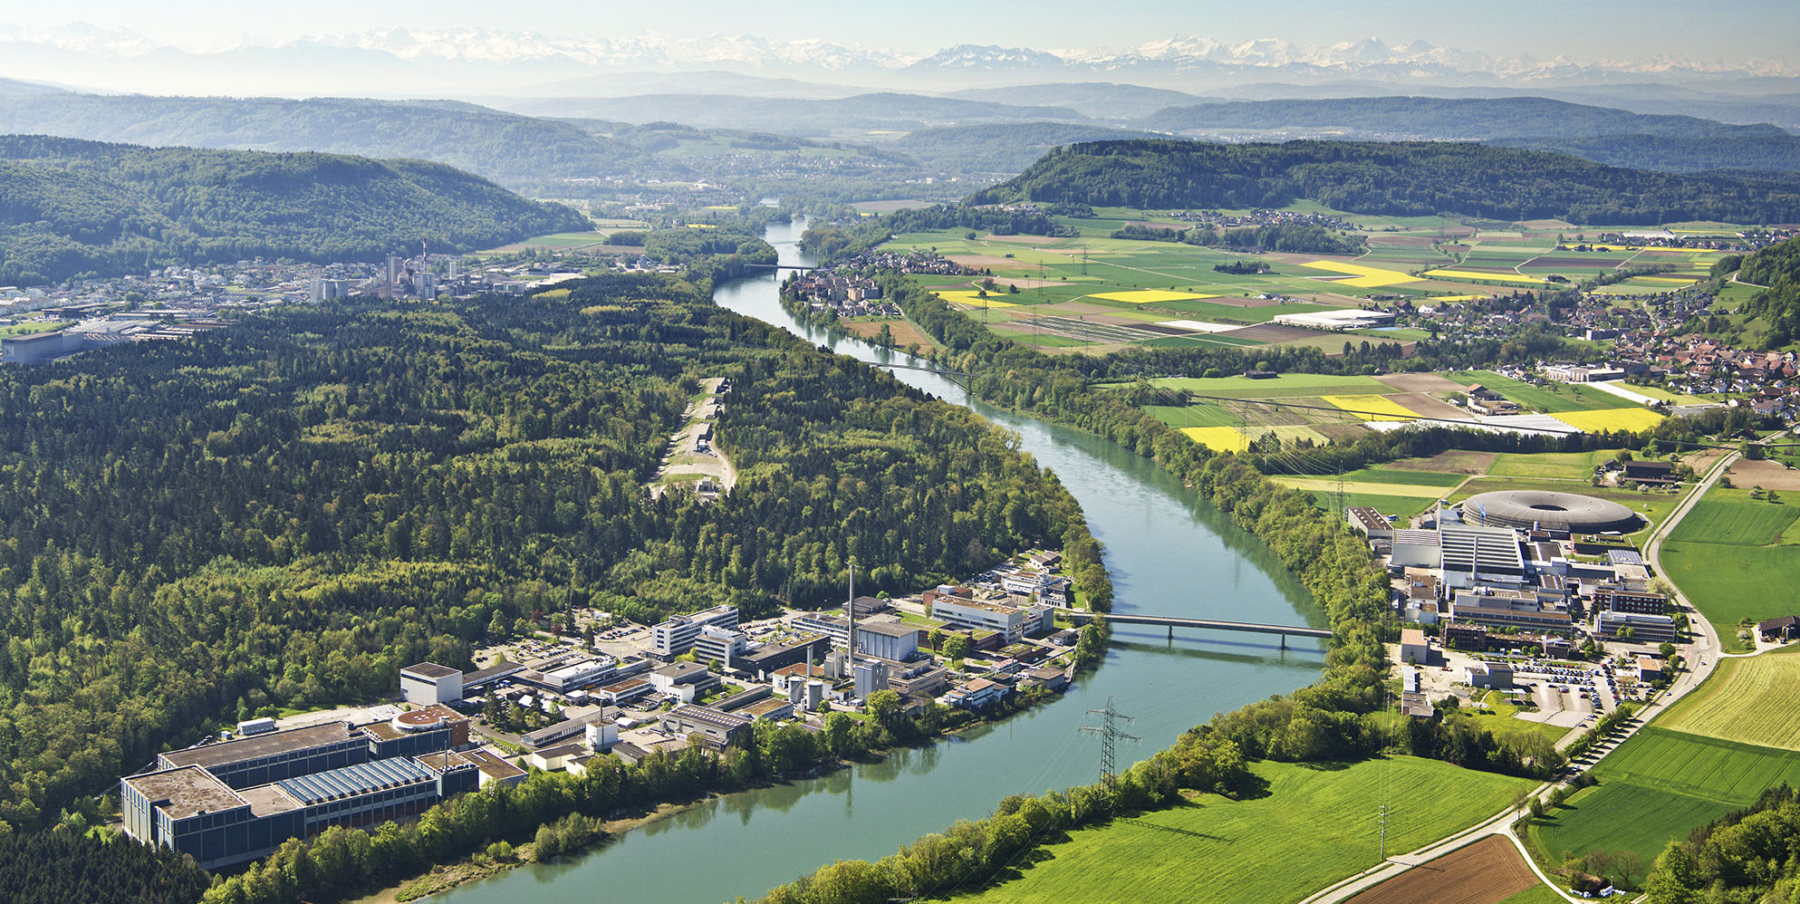
Facility Overview
Free Electron Laser
Proton Therapy Treatment
2018
SwissFEL
1991
PROSCAN
Synchrotron
2000
SLS
1974
HIPA: High Intensity Proton Accelerator
Particle physics, Neutron source, muon source
We are a group of ~30 people with 4 accelerators to support
They are used for science research and medical treatments
We support multiple generations of control system technology
We are very busy and feel very resource constrained !

Slide 6
PSI Controls – Services & Stakeholders
We provide
the control system for each of the running machines
technical support and development for the machine stakeholders
We have > 60 stakeholder groups
Machine Operators – who run our accelerators on a daily basis
Technical Specialists - who support the magnets, RF, vacuum systems, …
Scientists – who support the scientific users and who drive forward machine enhancements
It’s difficult to work out the optimal structure for our institute
we are now onto our third organizational structure in 6 years !
this is particularly challenging for our control system architectures !
“Any organisation that designs a system will produce a copy of the organisation’s own communication structure” – Conway’s Law
Our future architectures will need to be more flexible
if we move to less monolithic, finer-grained systems then responsibilities can be reassigned more easily and different components can evolve at different rates
Microservices might help, but evidence now shows such architectures incur significant additional costs !

Slide 7
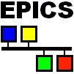

Use of EPICS
Previously PSI had multiple in-house control systems
Since 2009 we standardised on EPICS
Most of us agree this was a good idea… ☺
User Interface
…but, we can leverage EPICS in many different ways…
…and we don’t always agree the best approach…
"Intelligence”
The Control System Technical Stack
Hardware Interface
Sensors
Actuators

Slide 8


EPICS integration - Approach 1
EPICS Display Panels
“Use EPICS for the entire technology stack”
Display Panels
Display Manager
eg caQtDesigner +
caQtDm
Yay, with this design we can sometimes realise the dream of getting our users to create their own user interfaces… ☺
ca
EPICS IOCs
Intelligence
But… they are sometimes more like data interfaces than user interfaces ! ☹
eg VME, IFC, compact PCI,
SoftIOCs
Sensors
Actuators

Slide 9
EPICS integration – data interfaces vs user interfaces
The central abstraction of EPICS is a control point, or channel
User Interface points-of-interest
Display Panels
Display Manager
eg caQtDm
1 -1 mapping
ca
Control System channels
EPICS IOCs
Intelligence
eg VME, IFC, compact PCI,
SoftIOCs
What’s perhaps missing from this design is the GUI “intelligence” (= state manager) to help guide the users in their workflows
For trained operators this may be fine !
Sensors
Actuators
But for newbies the complexity can be frightening !

Slide 10
EPICS integration – Approach 2
“use EPICS as a flexible field bus, but use other technologies on top…”
Desktop Client Application
Desktop Client Application
eg X-Motif, Java Swing, C++/Qt,
Python/Qt
The user experience with a desktop client applications is potentially (but not always) richer ☺
Intelligence
ca
But it requires the enslavement services of a control system engineer ! ☹ (ideally one who cares about UX !)
EPICS IOCs
eg VME, IFC, compact PCI
Sensors
Actuators

Slide 11
Classic GUI Architecture at PSI
“You have to know the past to understand the present” - Carl Sagan 1980
SLS and SwissFEL were designed from the start to use EPICS
HIPA and PROSCAN started with a different control system architecture (ACS) and were migrated to EPICS later
Display Panel
caQtDm
Client Application
Java Swing, C++/Qt,
Python Qt
EPICS IOCs
Intelligence
Intelligence
eg VME, IFC, compact PCI,
SoftIOCs
EPICS IOCs
eg VME, IFC, compact PCI,
SoftIOCs
Sensors
Actuators
Sensors
Actuators
Fat IOC / Thin GUI Client
Thin IOC / Fat GUI Client
=> our GUI architectures of today are determined by events > 20 years ago !

Slide 12
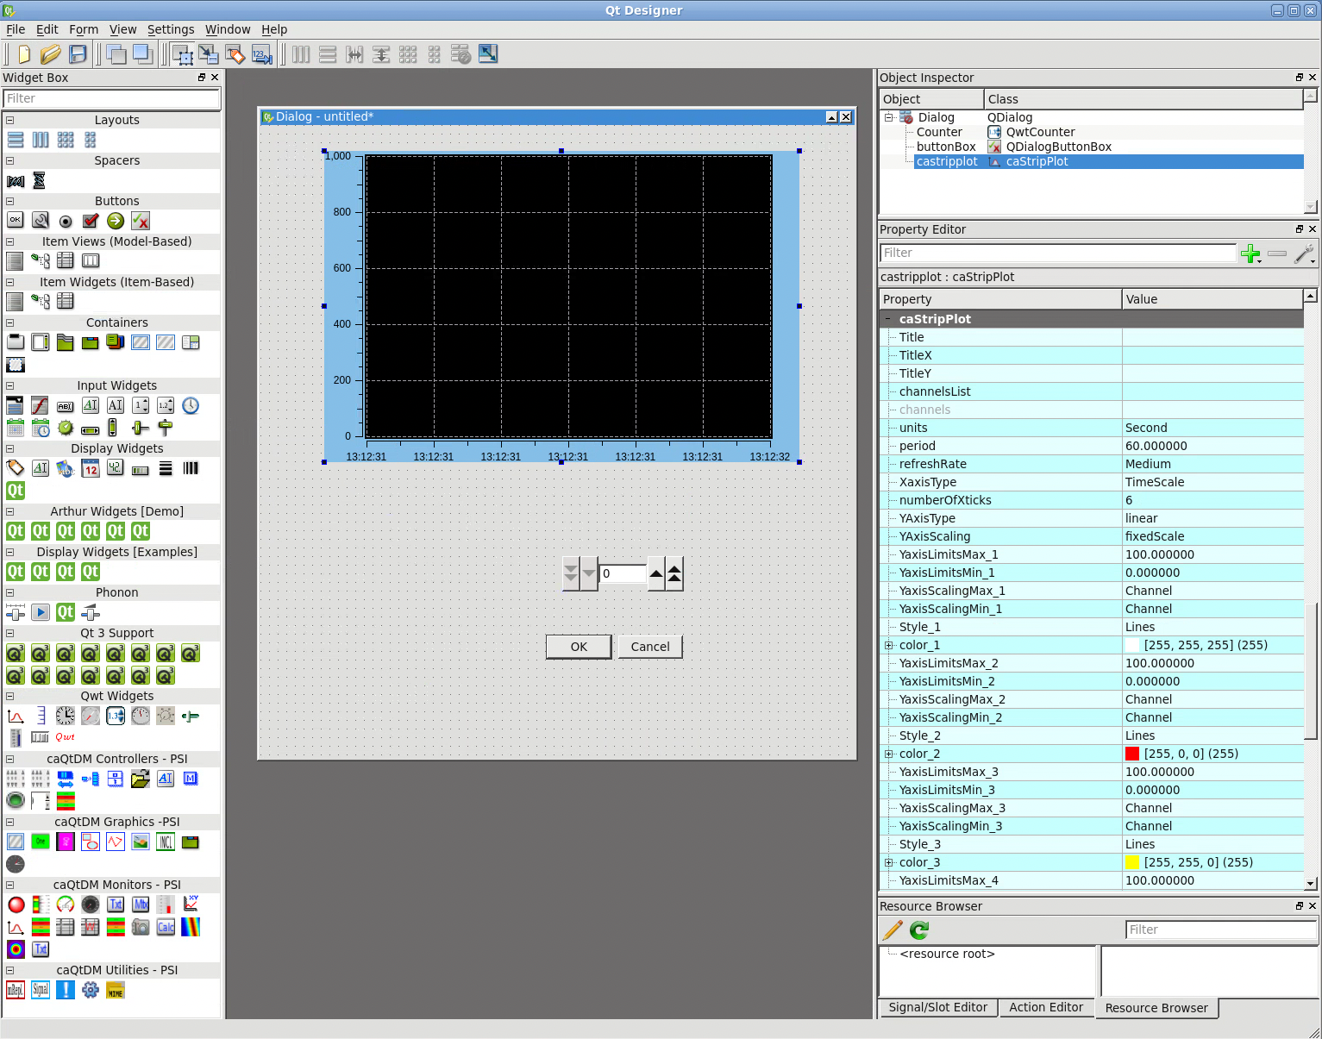

PSI Display Panels – how they are made
caQtDesigner
Credit: Dr Anton Christian Mezger
The “gold standard” against which any new tool offerings will be judged !
caGraph
Good enough in [x] % of use cases
[*] insert personal opinion here !
caButton
Widget toolbar
Canvas
Property Inspector
Used by: Machine Operators, Technical Experts, Control System Engineers

Slide 13








PSI Client Applications – how they are made
C++/Qt
Java / Swing
Python / Qt
A good IDE !
coffee !
effort !

Slide 14

Web-based approaches to GUI development

Slide 15




GUI Architectures at PSI – first web-based approach
For the new SwissFEL facility in ~2015 we started to use web-based technologies…
Use Case: Beam Synchronous Data Acquisition System
Main concepts
used ZeroMQ (not EPICS channel access) to stream data from the IOCs
used Web Components (Polymer) to provide the data retrieval user interface. No frameworks !
Web Browser
Data Retrieval
Polymer Web Components
REST API
Archiver
Learning Experiences
it worked ! ☺
need robust and well-defined APIs at all levels
good monitoring is very important for fast recovery
despite not using a heavyweight framework it was not easy to upgrade from Polymer to its successor Lit
Java/Spring Boot
EPICS IOCs
Data Streamer
ZeroMQ
VME, IFC, SoftIOC
Sensors
Actuators

Slide 16

GUI Architectures at PSI – second project - WICA
WICA = Web Interface for Controls Applications
Use Case: Facility Status Displays / Provide offsite Displays
Main concepts
Reflect control system points-of-interest onto html element data-* attributes
Use the received data to update text fields, plots, SVG displays, camera images etc onto the users display. This can be done in many ways.
Try to provide the users with some kind of tool or workflow so they can easily create their own displays
BYOI
“Bring your own intelligence”
Web Browser
Web Page
Intelligence
Wica-JS
JS Library
Server-Sent Event stream
REST API
Wica-HTTP EPICS Gateway
Java/Spring Boot
Learning Experiences
Partial success: WICA is the only display tool that works off-site
Getting the data to the user’s webpage is easy ☺
Providing a tool or workflow for the users (who are not programmers) has been difficult ☹
ca
EPICS IOCs
Sensors
Actuators

Slide 17
Leveraging WICA – supported workflows
Text-only Display Page
Display Page with Text and Plots
Display Page with Text and SVG
Display Page with Camera Images
Write some html to define your control points
Write some html to define your control points
Write some html to define your control points
Obtain a Web Component that supports rendering camera image data. At PSI we use Lit
Use an SVG Editor eg Boxy-SVG to create your graphic. Or create graphic with text editor
WICA will render the text content of your elements directly - no JS required.
Choose a JS plot library eg Plotly or Highcharts
Write some html to define the control points associated with each web component
Write some JS to update the plot using the received data
Write some JS to update the graphic using the received data

Slide 18
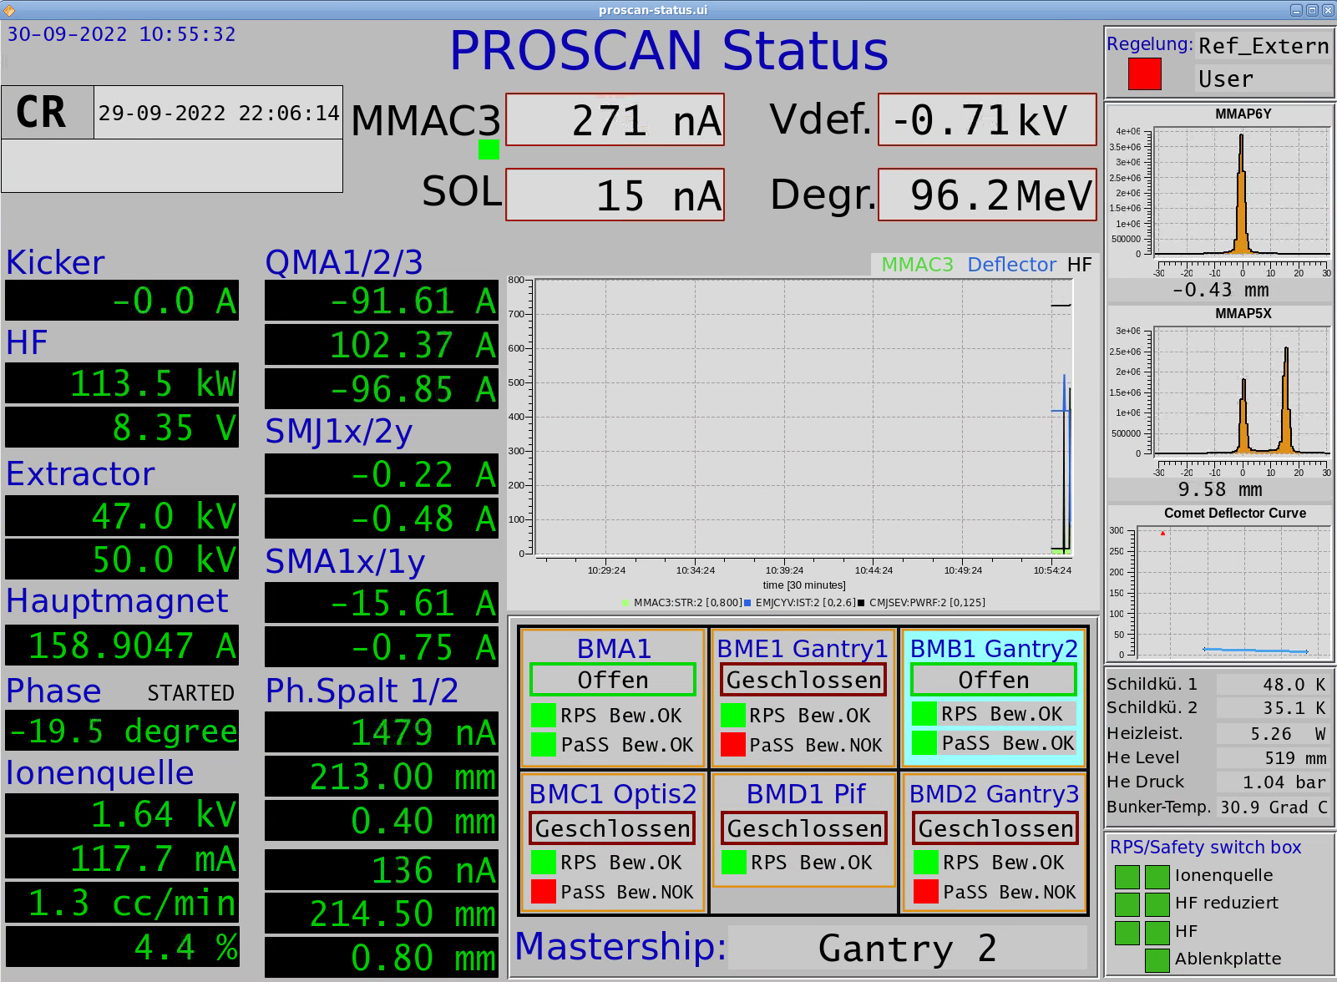
Web Upgrade Journey Start - PROSCAN Status Page
The original display page made with caQtDm
Ugly, but used effectively by many people !
Goal: make something just as ugly, but available on the web

Slide 19
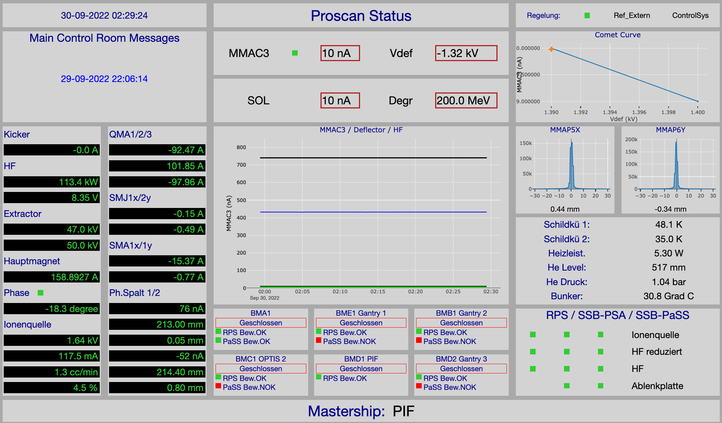

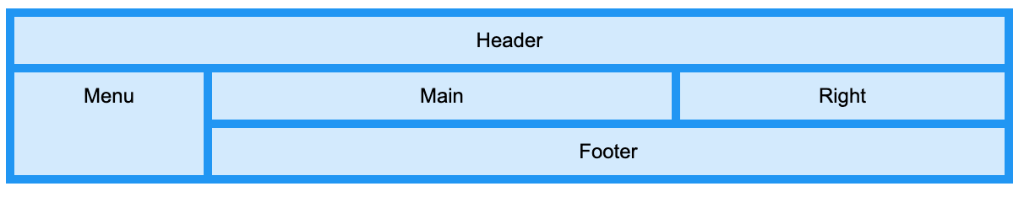
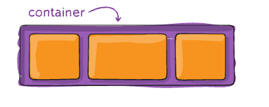
PROSCAN Status Page – Mixed Text & Plot Example
CSS3 Grid
CSS3 Flexbox

Slide 20
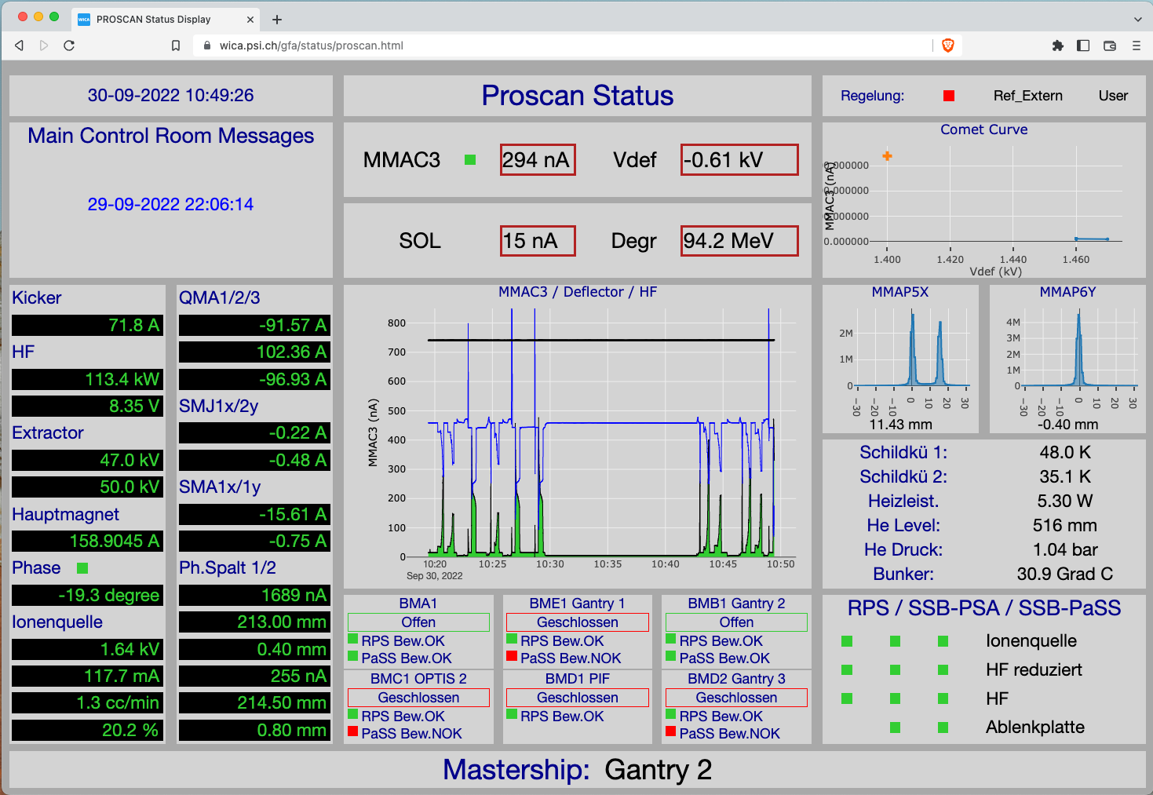
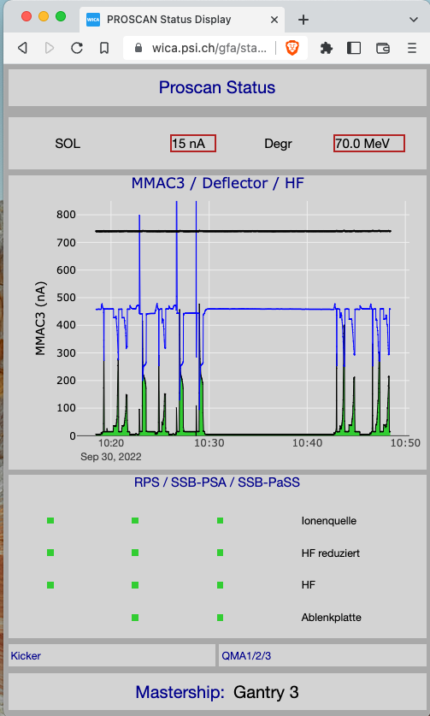
PROSCAN Status Page – responsive design
Because the pages just use normal web technology we can use CSS media queries to change the formats according to the features of the viewing device…

Slide 21

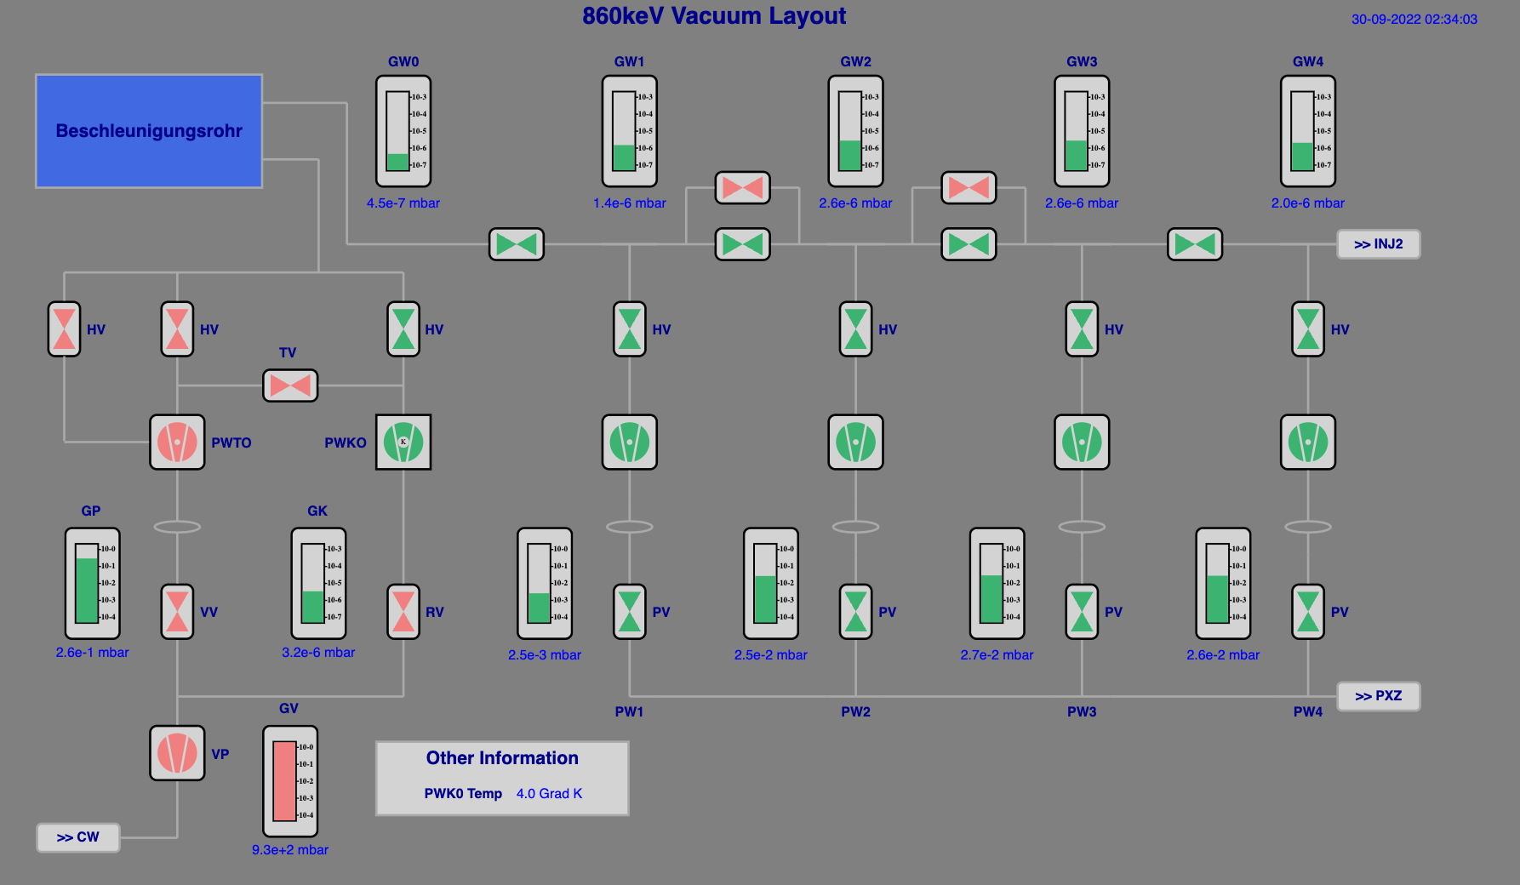

HIPA Vacuum System Page – SVG Example

Slide 22
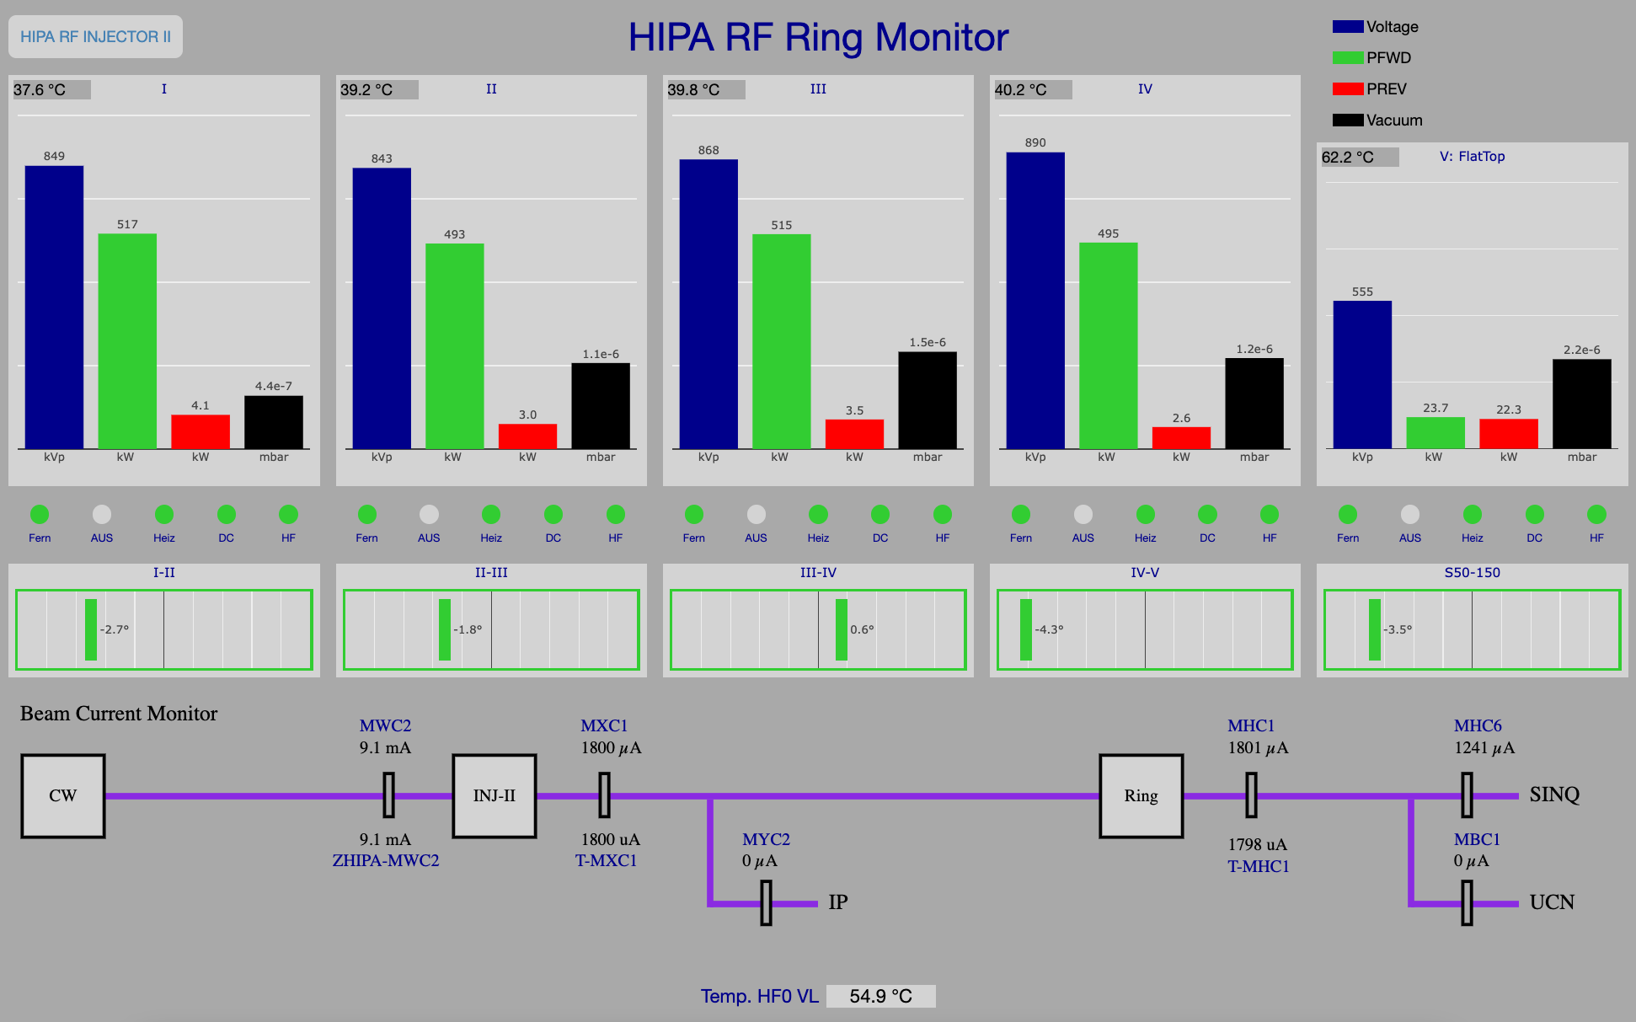
HIPA RF System Page – SVG + Plot Example

Slide 23
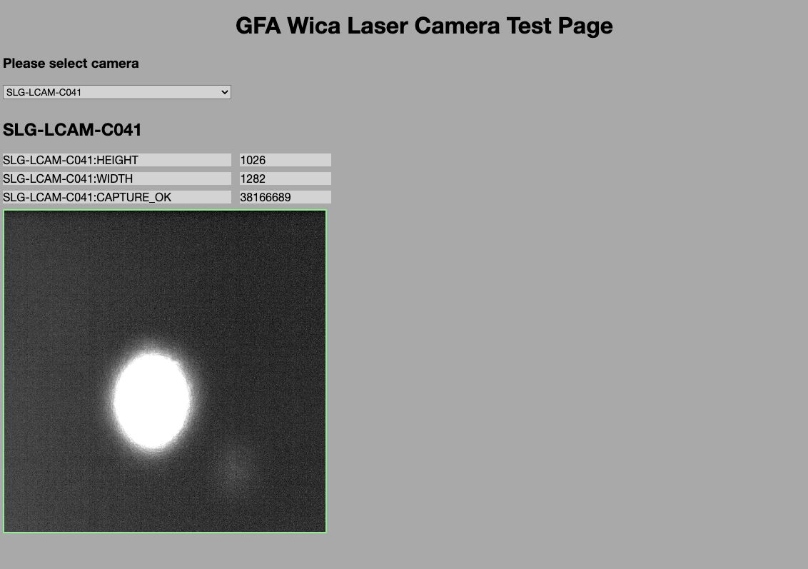

SwissFEL Camera Page – Web Component Example
Using Web Components enable us to create very clean html pages
<gfa-laser-camera-basic imageWidth="300" imageHeight="300" epicsDataChannel="SLG-LCAM-C081:FPICTURE"></gfa-laser-camera-basic>
But creating a web component control system library would require significant effort

Slide 24

Web-based approaches – balance sheet

Slide 25
Web Project - Benefits
Web technologies offer the leading paradigm for today’s software development. If we ignore them our controls solutions will be perceived as increasingly outdated and stuck in a timewarp ! Or worse, our users may simply choose to go elsewhere.
Richer state-of-the-art UX possibilities are now easily achievable. For example: animations, sound, speech synthesis, speech recognition, messaging can be integrated very quickly.
Since most of our web-based solutions are based on REST interfaces we get client side scripting possibilities for free (eg via curl).
Web technologies fit the demands of modern society: remote working flexible/hybrid work models; access anywhere on multiple platforms, onsite, whilst travelling, or at home.
Web technologies help our Pikett (on-call) support staff diagnose faults more quickly and efficiently, reducing down time.
The pool of trained web developers is much larger than the pool of, say, EPICS or TANGO developers. Using web technologies should make our recruitment easier.

Slide 26
Web Projects - Challenges
Richer, state-of-the art user experiences don’t come without effort. Are our labs willing to pay that price, or do they prefer to invest the effort elsewhere ?
Rich web applications tend to be created programmatically by software developers rather than by domain experts. Software engineers are not an easily scalable resource !
Currently at PSI, we have no Web GUI builder tools to offer to our users. Such a tool would be necessarily complex (if we hope to deliver richer UX) or rely on simplifying abstractions (where we throw away some of the advantages of the web).
Users may be reluctant to give up their old GUIs, even bad ones: “better the devil you know” ! The users sometimes resist our upgrade attempts unless there is a tangible payoff for them.
We have no automatic conversion tool for our existing 5000+ caQtDm panels. Should we even create a tool which would only clone the user interface experiences of the past with their more limited richness ?
The web is still in its infancy: as we try out and discard new approaches the rate of change is far higher than with our classical software development paradigms. There is an “impedance mismatch” between the lifecycle of web technologies and the lifecycle we would wish for the components used on our machines.

Slide 27
Web Projects – Future PSI Directions
The PSI Controls Group is currently very resource constrained and for the moment it cannot invest heavily in web development. At the moment we have no frontend team. ☹
Nevertheless, there are a number of web projects that are ongoing and we are hoping that our resource situation may change.
Current projects:
Upgrade of the SwissFEL data acquisition and archiving systems
Upgrade of the HIPA and PROSCAN interlock systems
Continue to use WICA to bring strategically chosen control system displays to the web in support of our Pikett teams and other remote workers
I am still pursuing the dream of a tool that would enable our users to create their own displays for the web ! ☺

Slide 28
Thank you for your attention :-)
A particular thank you to Chris Roderick for setting up this workshop
and to
Simon Ebner for making suggestions to these slides and Daniel Lauk, ex colleague and web guru !

Slide 29
Simple Wica Web Page Example
<!doctype html> <html lang="en"> <head> <meta charset="utf-8"/> <title>Wica Demo Page</title> <script src="/wica/wica.js" type="module"></script> </head> <body> <h1>Wica Demo Page</h1> <label>Channel-1:</label> <span data-wica-channel-name="SINEG01-MBND300:I-READ"></span> <br> <label>Channel-2:</label> <span data-wica-channel-name="SINLH02-MBND100:I-READ"></span> <br> <label>Channel-3:</label> <span data-wica-channel-name="SINBC02-MBND100:I-READ"></span> <br> </body> </html>

Slide 30

Attempting the risky – a live demo of WICA ?

Slide 31

Projects
Our projects vary enormously in size, scope and complexity…
Green Field Projects
Example “Build a Free Electron Laser”
Freedom to use new and improved technologies ☺
Often a top priority of the institute => more resources ☺
Plenty of engagement from the users and scientists ☺
Requirements less clear – we start off not knowing where the design journey will end
Time pressure can lead to settling for existing safe solutions rather than moving onwards to new technologies ☹

Slide 32
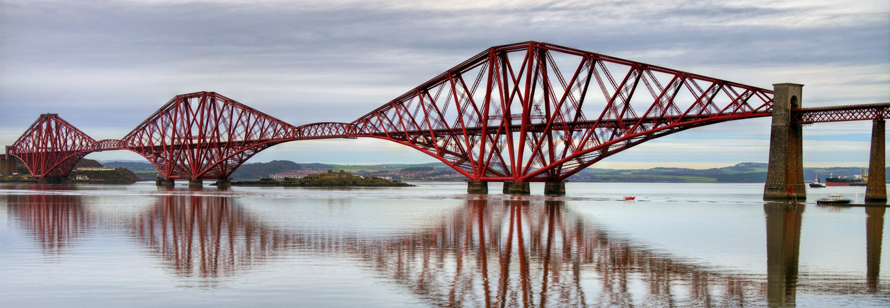
Projects
Our projects vary enormously in size, scope and complexity…
Upgrade Projects
Example “Upgrade the Machine Safety System at HIPA”
A never-ending task: painting the Forth Railway Bridge
Characteristics of the design/problem space are typically better understood ☺
Reduced time pressure (as long as the old solution still works) ☺
Less engagement from the users (unless there are significant feature enhancements) ☹
Less resources to do the work ☹
May need to migrate in steps => things can get more complicated in short term ☹
Footnote: in 2009 the use of new paint technology meant that it finally became possible to make breaks in the painting cycles !

